Slide 1
Financial Highlights
As of January 31, 2025

Slide 2
Highlights of Interim Financial Report (unaudited)
January 31, 2025

Slide 3
Posted on Our Website
Finance / Monthly Finance Reports (hcde-texas.org)
Linked from State Comptroller’s website
http://www.texastransparency.org/local/schools.php
3

Slide 4
Top 12 Highlights points for January 2025
$16.5M in tax revenue this month
$2.6M Debt Svc payments this month
TOT Revenues at 39% Target of 42%
TOT Expenditures at 41% Target of 42%
$41.2M in Equity as of Jan 2025
$145,666 in Donations
Values at $662B out of $665B Projected
Choice at $4.6M Benefit Variance
9. Ed Foundation at $525K
10. Ed Found Audit – Unmodified Opinion
11. 10% small business Jan25
12. 93% Irvington Project
13. Phase I Projects – just pending retainage release and closeout
14. Budget Process underway
Outlook Trend : Finance - Tax Revenues being received
Revenues and exp. Below target
Operations - Normal Operations and On Target
Policy - Stable
Legislative - On going
4

Slide 5
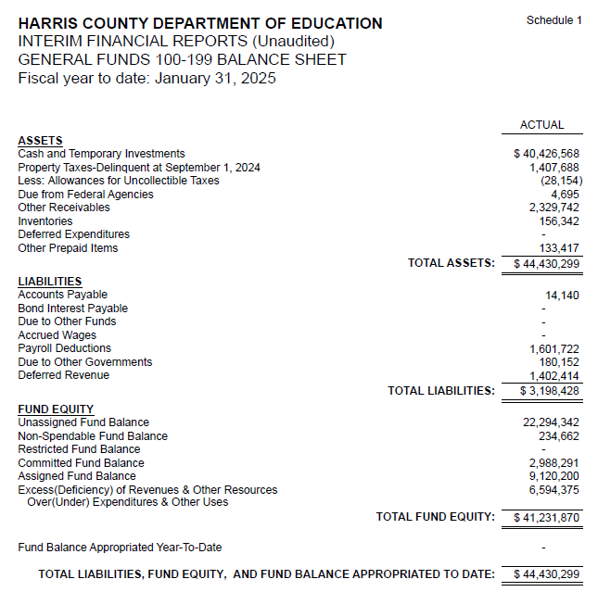
INTERIM FINANCIAL REPORT (unaudited) GENERAL FUND
Balance Sheet as of January 31, 2025
Total Assets:
$ 44,430,299
Total Liabilities:
$ 3,198,428
Total Fund Equity:
$ 41,231,870

Slide 6
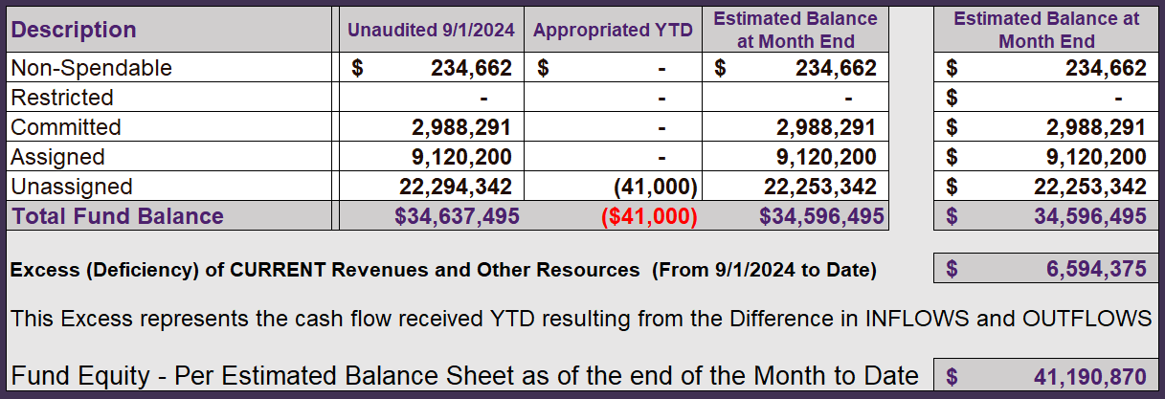
INTERIM FINANCIAL REPORT (unaudited) ASST. SUPERINTENDENT FOR BUSINESS SERVICES MESSAGE As of January 31, 2025
The ESTIMATED General Fund balance at 01/31/2025 is $41,190,870 after current appropriations.
As year end adjustments are completed, a budget amendment will be submitted to the board for items assigned, restricted and committed that will roll forward into FY 2025.
6

Slide 7
INTERIM FINANCIAL REPORT (unaudited) As of January 31, 2025 Financial Ratios
Level One - Indicator of Financial Strength
Level Two - Indicator of Efficient Leverage
Level Three - Indicators of Efficiency
Level Four - Indicators of Revenue Growth

Slide 8
INTERIM FINANCIAL REPORT (unaudited) As of January 31, 2025 Indicators of Financial Strength
Percent of Fund Balance to G/F
Expenditures Ratio
What is the percent of rainy-day fund balance?
(*) Unadjusted
Working Capital Ratio
What is the cash flow availability for the organization?
Unassigned Fund Balance $ 22,294,342
Total G/F Expenditures $ 28,181,118
Goal : > 30% of G/F Exp.
Benchmark: 10% to 29%
Danger: Under 10%
Goal : >$15,000,000
Benchmark : $10M to $15M
Danger : Under < $10M
Total Current Assets
Less Total Current Liabilities
$44,430,299-$3,198,428=$41,231,871
79% FY25
67% FY24
$41M FY25
$39M FY24
Budgeted 24%
Details on Schedule 3
Budgeted $33M
Details on Schedule 1

Slide 9
INTERIM FINANCIAL REPORT (unaudited) As of January 31, 2025 Indicators of Efficient Leverage Reserves
Unassigned Fund Balance Ratio
How much is available in reserves?
Debt to Income Ratio
What is the ability of HCDE to cover
its debt payments?
Unassigned Fund Balance $22,294,342
Total Fund Balance $41,231,870
Annual Principal and Interest Payments on
Term Debt and Capital Leases : $2,598,038
G/F Revenue Less Facility $34,775,494-3,194,032
Charges :
Goal: <75%
Benchmark: 50% to 75%
Danger: <50%
Goal: <25% of annual revenue
Benchmark: 25% to <49%
Danger: Over > 50%
54% FY25
42% FY24
8% FY25
0% FY24
Budgeted 71%
Details on Schedule 1
Budgeted 6%
Details on Schedule 5

Slide 10
INTERIM FINANCIAL REPORT (unaudited) As of January 31, 2025 Indicators of Efficiency
Tax Revenue to Total Revenue Ratio
How efficient is HCDE at leveraging local
taxes? (Current)
Indirect Cost to Tax Ratio
How much dependency on indirect cost from grants?
Current Tax Revenue $19,773,563
Indirect Cost General Fund $928,679
Total Revenue $ 57,168,650
Total General Fund Revenues $34,775,494
Total General Fund Revenues $1,306,381
Goal: <20% of revenue
Benchmark: 20% to 30%
Danger: Over >30%
Goal: >5%
Benchmark: 2% to 5%
Danger: Under < 2%
Goal: >5%
Benchmark: 2% to 5%
Danger: Under < 2%
34% FY25
27% FY24
2.7% FY25
3.3% FY24
Budgeted 25%
Details on Schedule 2
Budgeted 2.5%
Details on Schedule 3

Slide 11
INTERIM FINANCIAL REPORT (unaudited) As of January 31, 2025 Indicators of Revenue Growth
Fee for Service Revenue Ratio
How are revenues spread across all Funds?
Fee for Service Revenue Growth Ratio
What is the market growth for fee on services?
Total Fee for Service Revenues (G/F) $8,515,491
Total Revenues $57,168,650
Fee for Service Current Year Less Fee for Services Last Year $8,515,491,-17,229,430
Fees for Service Last Year $17,229,430
Goal: >30% of annual revenue Benchmark: 10% to 29%
Danger: Under 10%
Goal: >3% of + growth
Benchmark: 0% to 3%
Danger: Under 0%
14% FY25
31% FY24
-50% FY25
42% FY24 ​
Budgeted 19%
Details on Schedule 14
Budgeted 17%
Details on Schedule 14

Slide 12
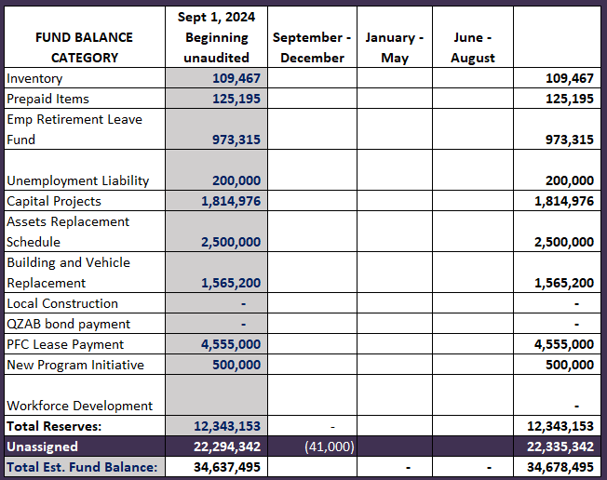
FY 2024-2025 Fund Balance - Budgeted Activity

Slide 13
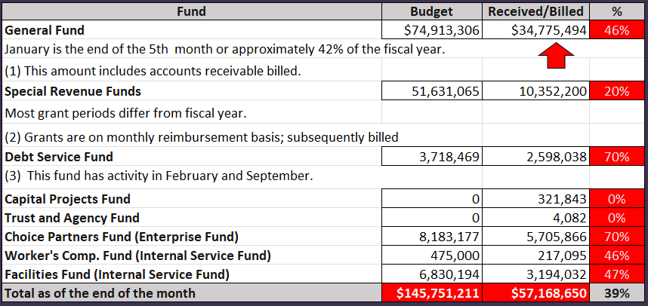
INTERIM FINANCIAL REPORT (unaudited) GENERAL, SPECIAL REVENUE, DEBT SERVICE FUNDS, CAPITAL PROJECTS,
AND INTERNAL SERVICE FUNDS
REVENUES (INFLOWS)
Budget to Actual for period ending January 31, 2025

Slide 14
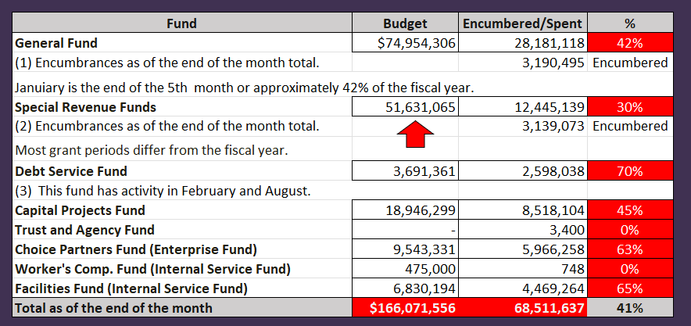
INTERIM FINANCIAL REPORT (unaudited)
GENERAL, SPECIAL REVENUE, DEBT SERVICE FUNDS, CAPITAL PROJECTS,
AND INTERNAL SERVICE FUNDS Expenditures (OUTFLOWS)
Budget to Actual for period ending January 31, 2025

Slide 15
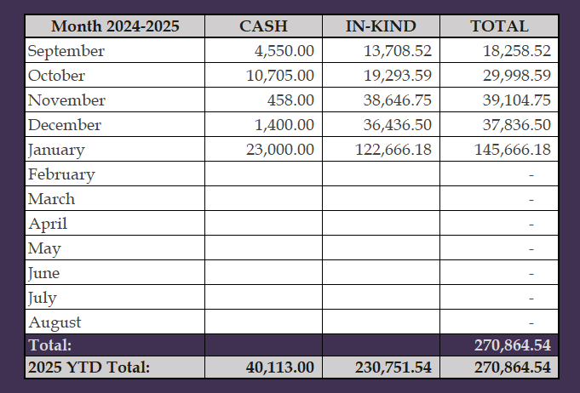
INTERIM FINANCIAL REPORT (unaudited) FY 2024-25 Donations Report All Funds as of January 31, 2025

Slide 16
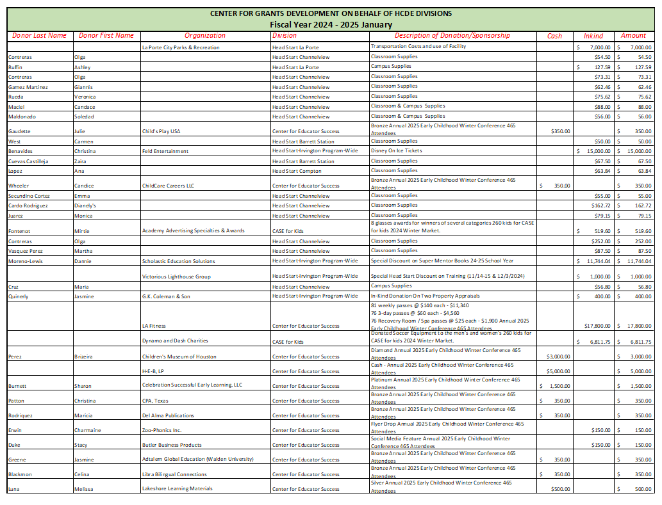
INTERIM FINANCIAL REPORT (unaudited) FY 2024-25 Donations Report All Funds as of January 31, 2025

Slide 17
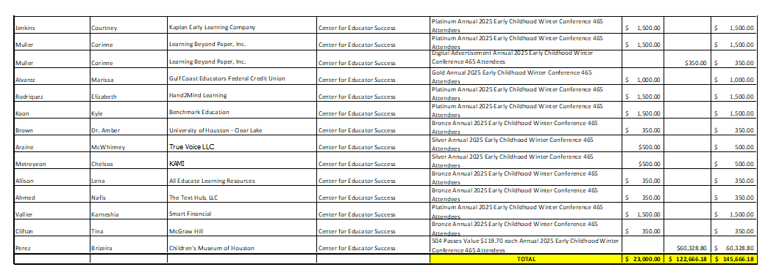
INTERIM FINANCIAL REPORT (unaudited) FY 2024-25 Donations Report All Funds as of January 31, 2025

Slide 18
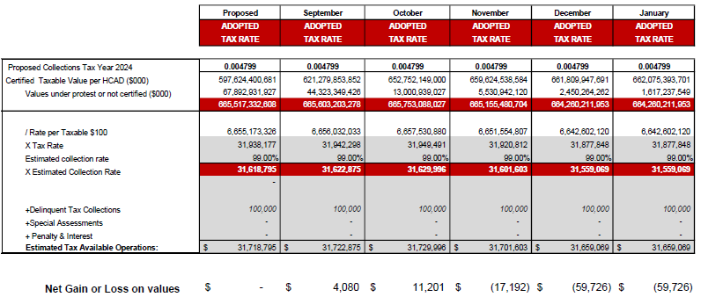
INTERIM FINANCIAL REPORT (unaudited) TAX COLLECTIONS COMPARATIVE ANALYSIS Fiscal Year-To-Date as of January 31, 2025
$664 B
See Tax Calculator at:
https://hcde-texas.org/transparency/tax-rate/

Slide 19
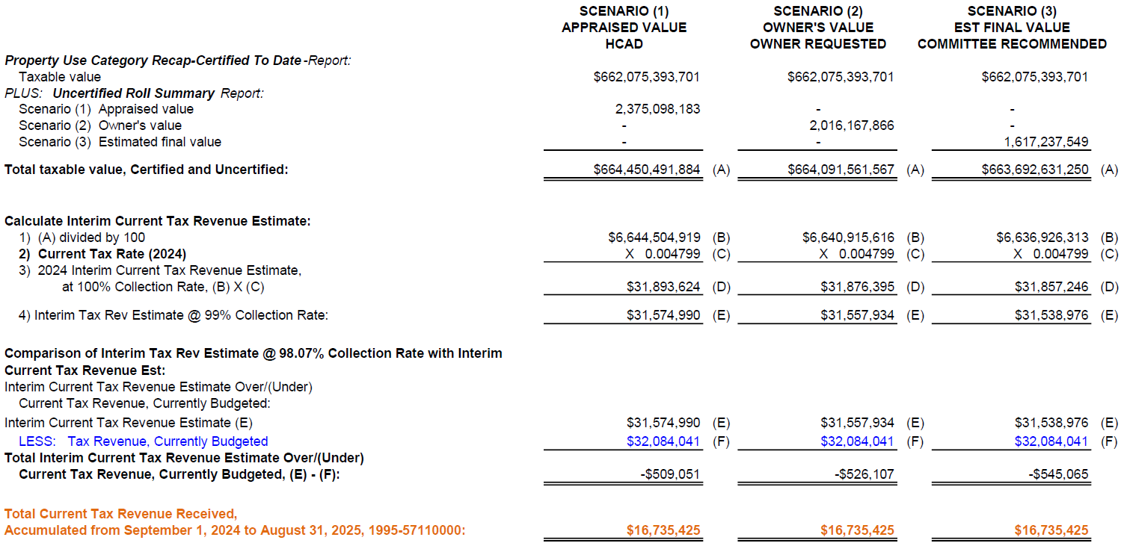
INTERIM FINANCIAL REPORT (unaudited) TAX COLLECTIONS
Fiscal Year-To-Date as of January 31, 2025
(5th month / 12 months)

Slide 20
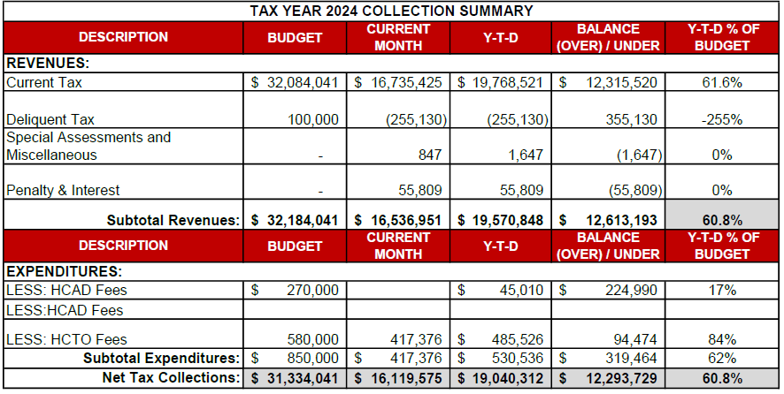
INTERIM FINANCIAL REPORT (unaudited) TAX COLLECTIONS
Fiscal Year-To-Date as of January 31, 2025
(5th month / 12 months)
a) 2024 Approved Tax Rate = $0.004799/$100 Property Assessment/Appraisal - --> Annual Tax on a $259,375 - $51,875 = $207,500/100
x .004799 = $9.958 (net of 20% homestead exception.)
b) $850,000/$32,184,041 = 2.64% Collection and assessment costs

Slide 21
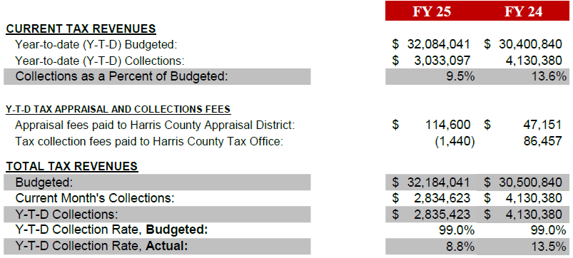
INTERIM FINANCIAL REPORT (unaudited) TAX COLLECTIONS
Fiscal Year-To-Date as of January 31, 2025
(5th month / 12 months)
a) 2024 Approved Tax Rate = $0.004799/$100 Property Assessment/Appraisal - --> Annual Tax on a $259,375 - $51,875 = $207,500/100
x .004799 = $9.958 (net of 20% homestead exception.)
b) $850,000/$32,184,041 = 2.64% Collection and assessment costs

Slide 22
INTERIM FINANCIAL REPORT (unaudited) DISBURSEMENT – ALL FUNDS January 31, 2025
Notes:
All Purchase Orders and Payment Authorizations are reviewed before disbursement.
All Procurement Card charges are reviewed by cardholder, supervisor, and business office staff each month.
A report on CH Local Expenditures is included in the monthly report.

Slide 23
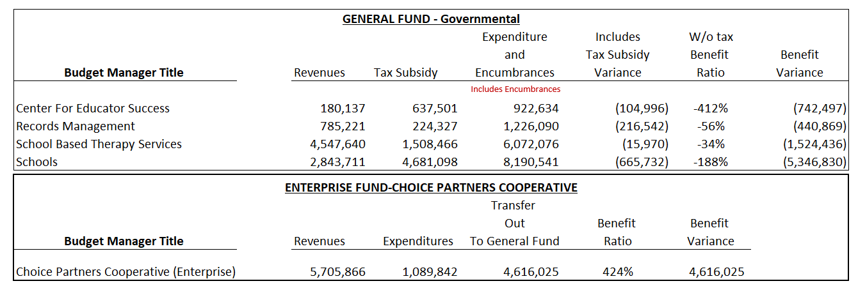
INTERIM FINANCIAL REPORT (unaudited) Segment Division Data As of January 31, 2025

Slide 24
HIGHLIGHTS OF BUDGET AMENDMENT REPORT February 26th, Board Meeting (unaudited)

Slide 25
Education Foundation Update
January 31, 2025
25

Slide 26
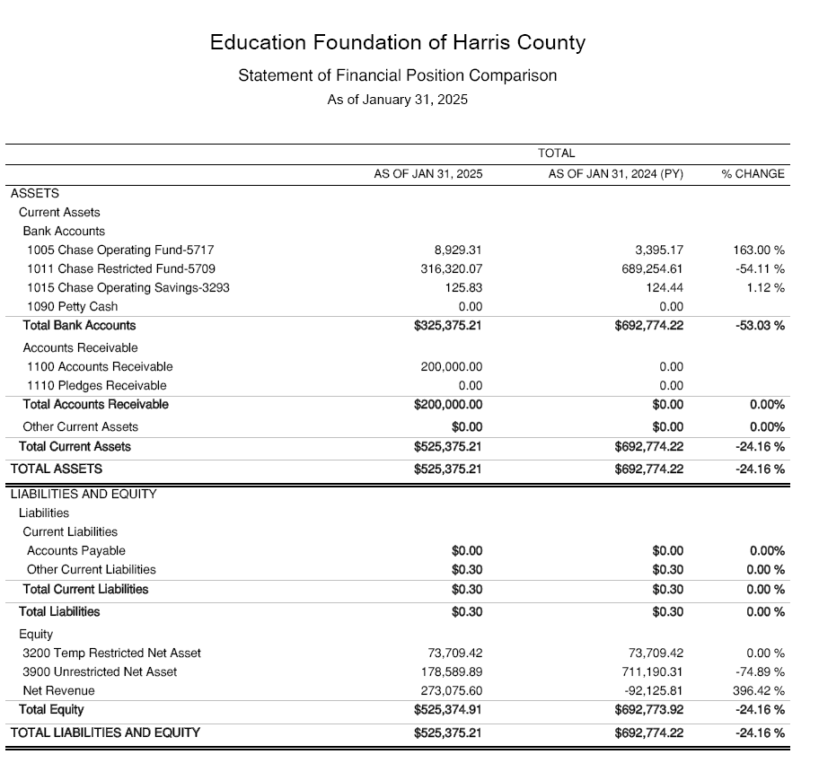
Statement of Financial Position
Net Equity
$525,374

Slide 27
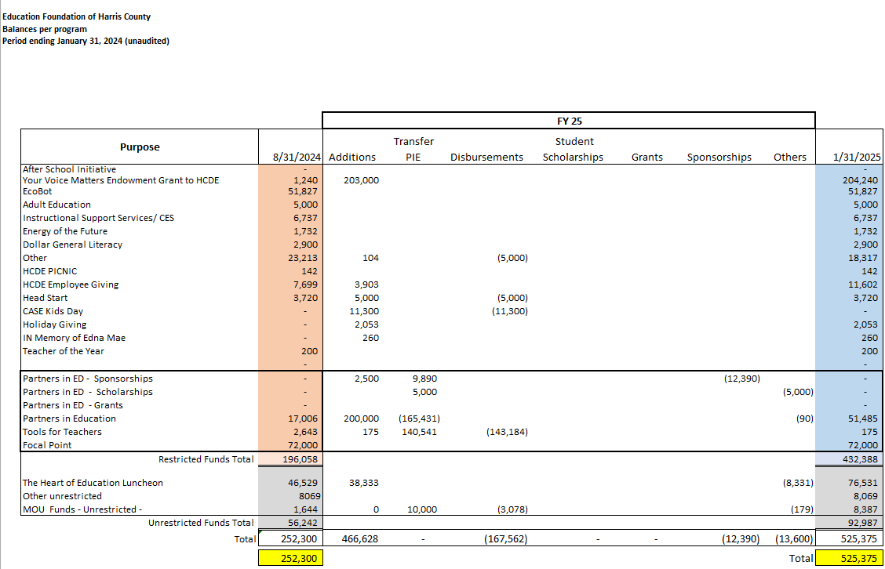
Ed Foundation Balances Per Program
Note Includes the $200K in FY 24-25

Slide 28
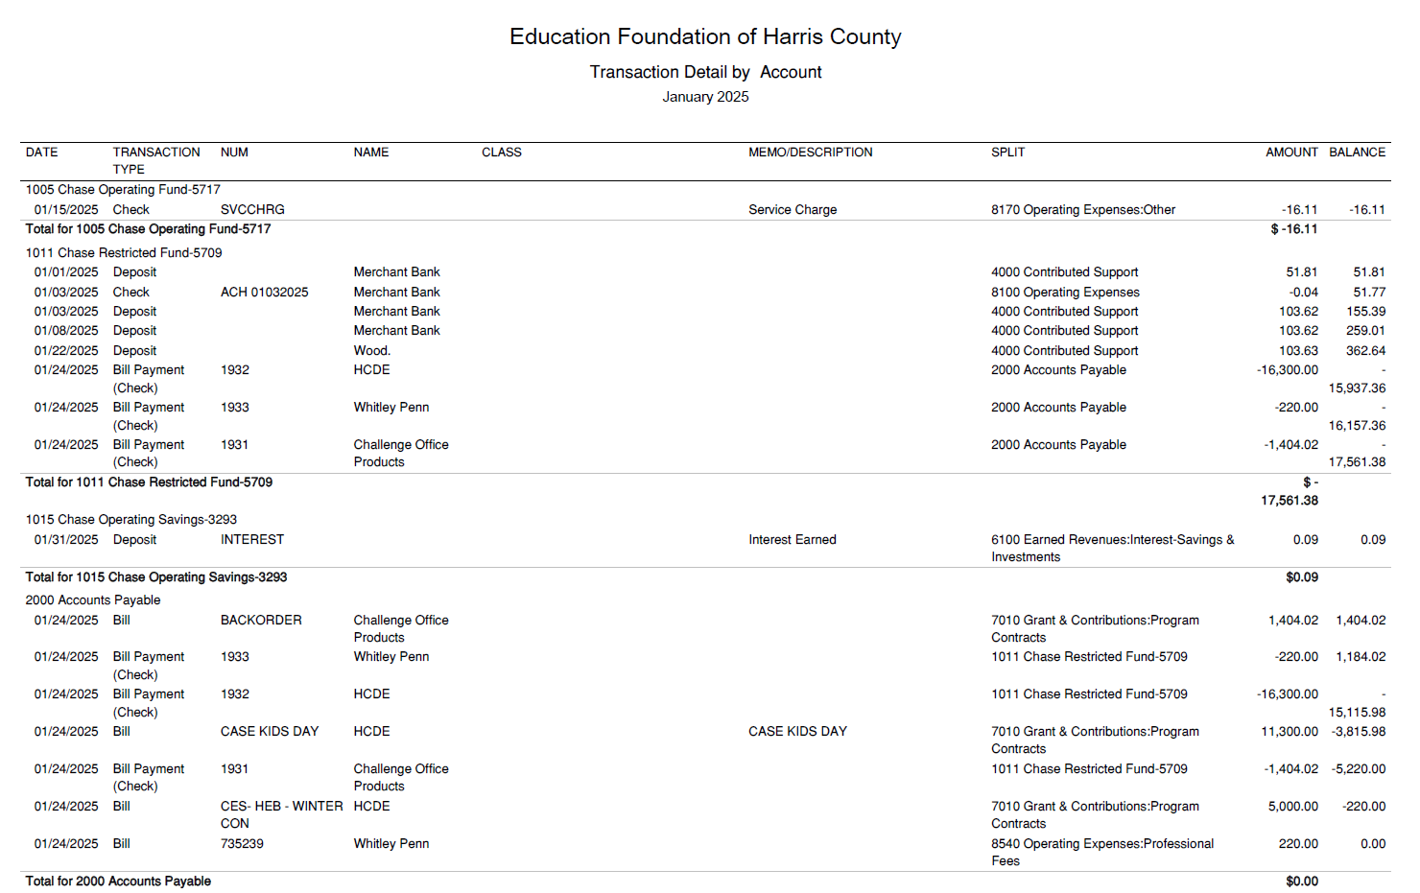
Transaction Detail by Inflow & Outflow

Slide 29
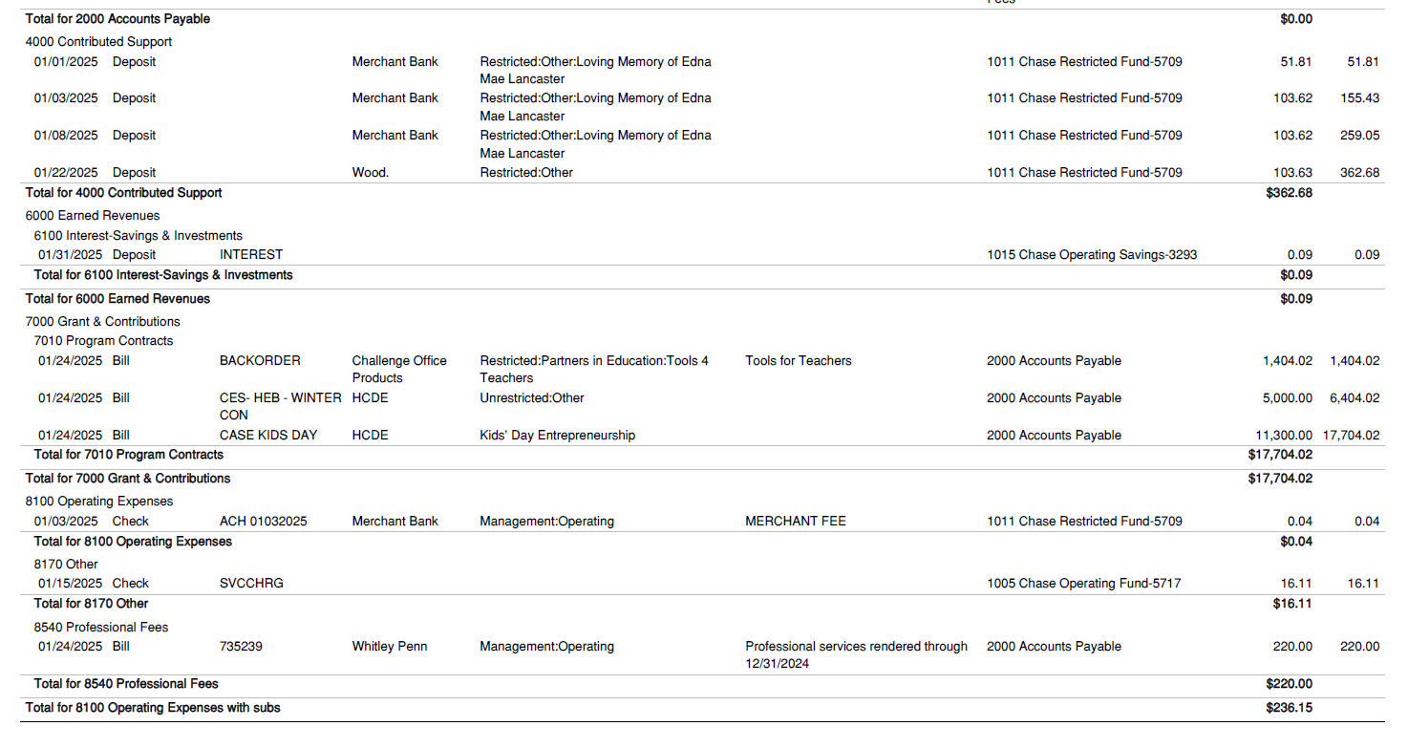
Transaction Detail by Inflow & Outflow

Slide 30
PFC & Lease Revenue Projects Update
January 31, 2025
30

Slide 31
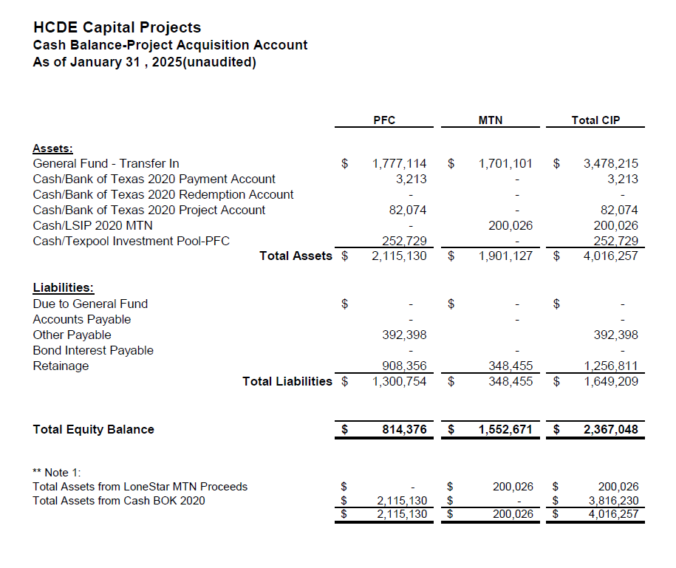
AB East School Contract $12,358,000 Awarded
Adult Ed Center Contract $15,121,000 Awarded on Oct 2021 Board Mtg
HP East Contract $7,271,000 Awarded on Nov 2021
Irvington – $11,172,589 Awarded on Jan 2024
Cash Balance –
Project Acquisition Account
As of January 31, 2025
31

Slide 32
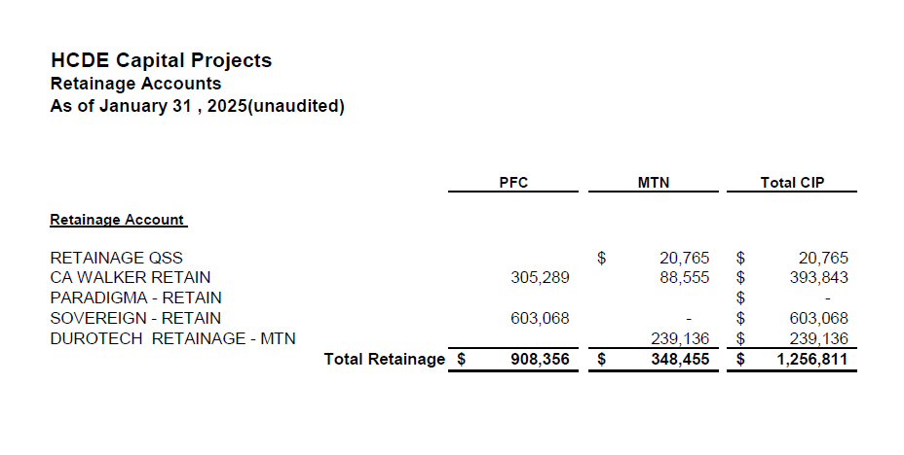
2020 MTN NOTES/2020 PFC BONDS
Pending Retainage Payable
Retainage Payable
Project Acquisition Account
As of January 31, 2025
32

Slide 33
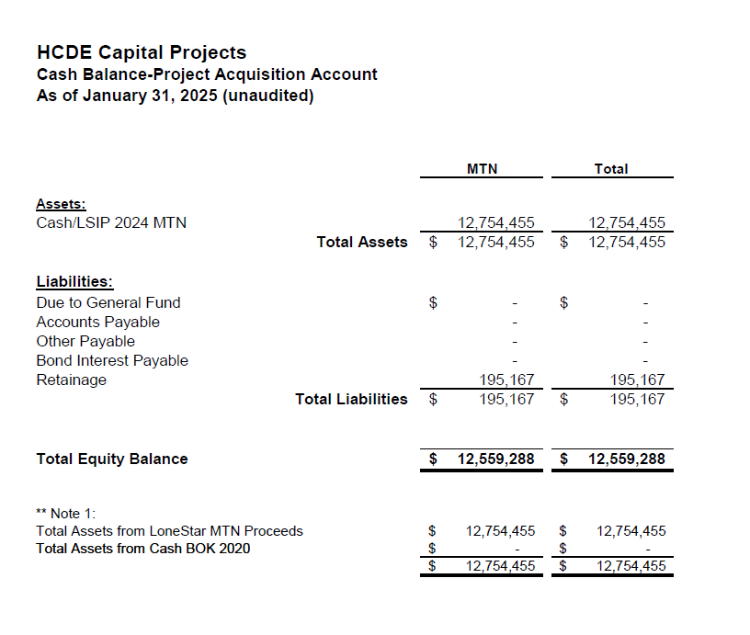
AB West $333,000 March 2024 Board Mtg
HS Barrett Station $470,000 March 2024 Board Mtg
Fortis Academy $650,000 March 2024 Board Mtg
Irvington – $9,860,000 March 2024 Board Mtg
Post Oak - $5,000,000 March 2024 Board Mtg
$16,313,000
Cash Balance –
2024 Maintenance Notes
As of January 31, 2025
33

Slide 34
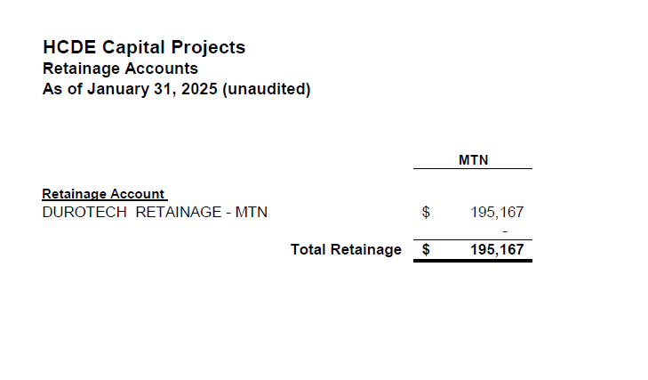
AB West $333,000 March 2024 Board Mtg
HS Barrett Station $470,000 March 2024 Board Mtg
Fortis Academy $650,000 March 2024 Board Mtg
Irvington – $9,860,000 March 2024 Board Mtg
Post Oak - $5,000,000 March 2024 Board Mtg
$16,313,000
Retainage Payable
2024 Maintenance Notes
As of January 31, 2025
34

Slide 35
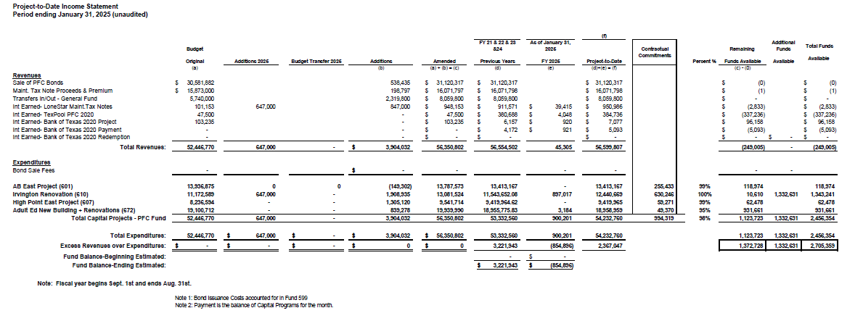
Income Statement– Project Acquisition Account
As of January 31, 2025
35

Slide 36
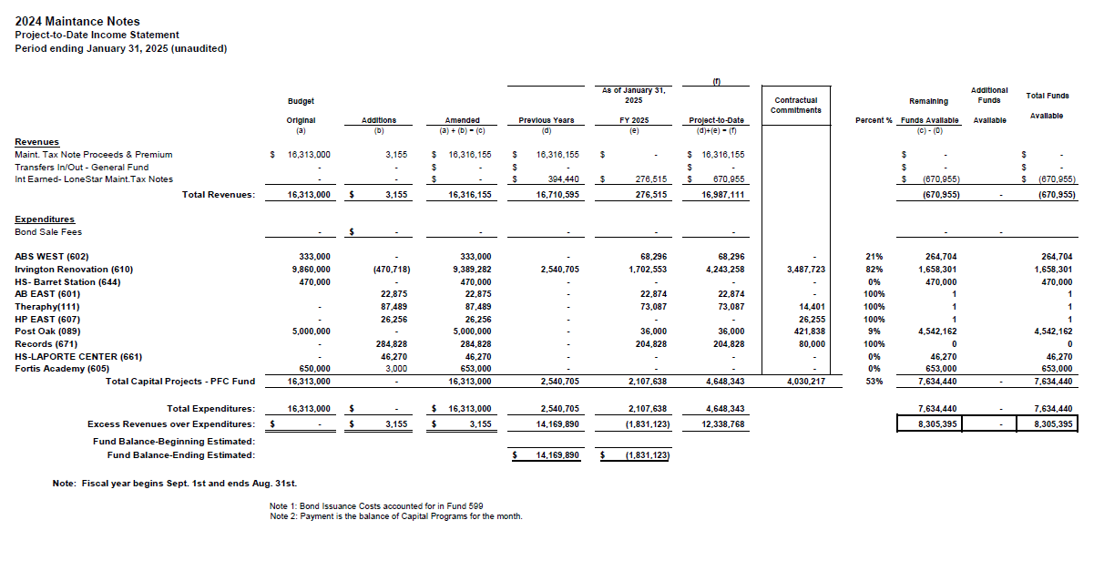
Income Statement– 2024 MNT NOTES
As of January 31, 2025
36

Slide 37
Irvington Renovation – Funds by Source
As of January 31, 2025
Irvington Renovation 2020 Maintenance Notes $ 4,781,519
Contract 2024 Maintenance Notes $ 7,000,000
Total $11,781,519
37

Slide 38
Interim Financial Report (unaudited)
I certify that the foregoing information is true and accurate to the best of my knowledge.
/s/ Jesus J. Amezcua, RTSBA,CPA, Ph.D., CPFIM, Asst. Supt. for Business Support Services
/s/ Marcia Leiva, Chief Accounting Officer

